Slide 1
© 2018 Cengage Learning®. May not be scanned, copied or duplicated, or posted to a publicly accessible website, in whole or in part.

Slide 2
Marketing Strategy
16
© 2018 Cengage Learning.® May not be scanned, copied or duplicated, or posted to a publicly accessible website, in whole or in part.

Slide 3
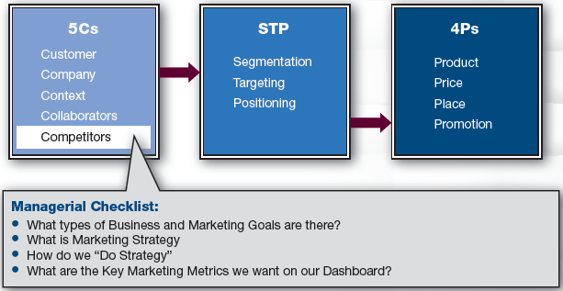
Marketing Framework
3

Slide 4
Discussion Question #1
How can companies become more profitable?
4

Slide 5
Marketing Goals
Profit = Sales Revenue – Costs
Sales Revenue = Sales Volume  Price
Costs = Variable Costs + Fixed Costs
Thus, Profit = (Sales Volume  Price) – [Variable Costs (Unit Cost  Sales Volume) + Fixed Costs]
Growing profit is the ultimate marketing goal
5

Slide 6
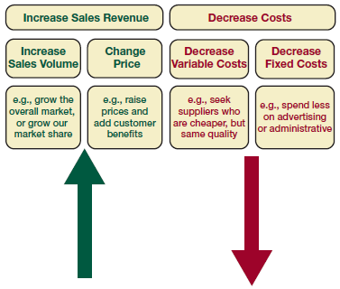
Increasing Profitability
To increase profitability, companies can
Increase sales volume
Change prices
Decrease costs
6

Slide 7
Profitability: Growing Sales (slide 1 of 2)
To grow sales volume, companies can
Grow the overall market or grow the company’s market share
Up-sell current customers to more expensive offerings
Get customers to buy more frequently
Steal customers from competitors
Pursue another segment
7

Slide 8
Profitability: Growing Sales (slide 2 of 2)
To grow sales volume, companies can, (continued)
Create new products
Reduce brand switching by enhancing brand
Raise customer satisfaction
Add value through a loyalty program
Raise switching costs so leaving brand is unattractive
8

Slide 9
Profitability: Changing Prices
To change prices, companies can
Cut prices
May bring volume in short term, but may damage brand image/equity
May create price wars
Lower price necessitates higher volume
Raise prices
Yields greater margins
Cues high quality
May need to shift to a more upscale target
9

Slide 10
Profitability: Decreasing Variable Costs
To decrease variable costs, companies can
Find less expensive suppliers
Outsource parts of the business to partners who are more efficient
Become a niche provider to keep units down and price higher for special customers
10

Slide 11
Profitability: Decrease Fixed Costs
To decrease fixed costs, companies can
Spend less on R&D
Spend less on advertising
Be more creative and efficient with spending
Milk the brand
Don’t spend on continued development or maintenance
11

Slide 12
Marketing Strategies
Ansoff’s product-market growth matrix
BCG matrix
General Electric model
Porter strategies
Treacy and Wiersema strategies
12

Slide 13
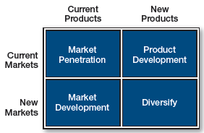
Ansoff’s Growth Matrix (slide 1 of 3)
13

Slide 14
Ansoff’s Growth Matrix (slide 2 of 3)
Market penetration: current products, current markets
e.g., Convincing our current users to drink Pepsi for breakfast
Market development: current products, new markets
e.g., Selling chalk not only to schools, but also to kids
14

Slide 15
Ansoff’s Growth Matrix (slide 3 of 3)
Product development: new products, current markets
e.g., Selling dry-erase boards to customers to whom you are currently selling dry-erase markers
Diversification: New products, new markets
e.g., A bookstore selling music
15

Slide 16
Ansoff’s Growth Matrix Questions
Describe how Apple could implement a
Market penetration strategy
Product development strategy
Market development strategy
Diversification strategy
Which strategy do you think Apple primarily uses?
16

Slide 17
BCG Matrix
Brands or products are classified according to whether each has a strong or weak market share and slow or growing market
Star: high share, high growth
Cash cow: high share, low growth
Question mark: low share, high growth
Dog: low share, low growth
17

Slide 18
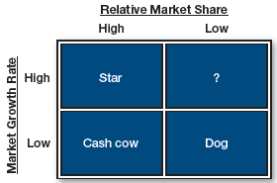
BCG Matrix Questions
Give examples of
A star
A cash cow
A question mark
A dog
18

Slide 19
BCG Matrix Strategies
Stars: Optimize or hold
Cash cows: Milk
Question marks: Invest or divest
Dogs: Minimize or divest
If stars and cash cows are sufficiently profitable, companies can carry question marks and dogs
19

Slide 20
General Electric Model (slide 1 of 3)
Measures market attractiveness and business strength
Weights: How important dimension is
Constrain to 1.0
Rating: How the company is doing
1 = awful and 5 = outstanding
20

Slide 21
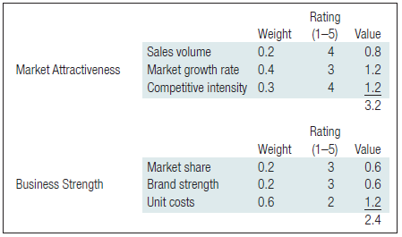
General Electric Model (slide 2 of 3)
21

Slide 22
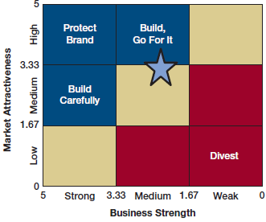
General Electric Model (slide 3 of 3)
22

Slide 23
Porter’s Strategies
Porter’s strategies
Companies can dominate in 1 of 3 ways
Cost leadership
Produce more efficiently than competition
Differentiation
Distinguish one’s products as unique
Focused
Do one thing very well
23

Slide 24
Treacy and Wiersema’s Strategies
Operational excellence: Deliver products smoothly, reliably
e.g., IKEA, TurboTax
Product leadership: Excellent quality; innovation
e.g., Apple, BMW
Customer intimacy: Knowledge of customer needs
e.g., Amazon, Home Depot
24

Slide 25
Doing Strategy
Company must know its 5 Cs and understand its identity
Reasons to revisit strategic planning
To revisit assumptions
To launch new initiatives
When contextual issues change
When financial performance changes
25

Slide 26
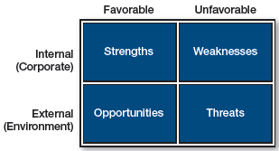
SWOT
SWOT: Strengths, weaknesses, opportunities, threats
26

Slide 27
SWOT: Strengths and Weaknesses
Understand identity in marketplace
Is the company
Innovative or conservative?
Offensive or defensive?
Leaders, followers, quick followers, also-rans, or barely-in-the-games?
Companies may behave differently in different industries
Company approach may vary with product lifecycle, 5 Cs, etc.
27

Slide 28
SWOT: Opportunities and Threats
Consider opportunities and threats in marketplace
e.g., New competitors, economy decline, changes in regulations
Strategies
Do nothing
Do nothing differently
Do something different
28

Slide 29
Do Something Differently (slide 1 of 2)
Let’s make more money
State sales objectives in terms of currency, market share, units, change from last year or quarter, region, growth, ROI, ROE, ROM, etc.
Let’s delight our customers
Enhance customer satisfaction, create loyalty program, reward customers, offer personalization, etc.
29

Slide 30
Do Something Differently (slide 2 of 2)
Let’s reposition our brand
Must integrate all 4Ps
Change product, place, price, and/or promotion
Goals beyond marketing
Charitable or community contributions
Boosting stability of local employment
Demonstrating leadership in environmentally friendly business practices, etc.
30

Slide 31
Marketing Metrics (slide 1 of 3)
Measure what matters
e.g., Profitability, sales, share, average prices, levels of awareness, customer satisfaction, employee satisfaction
31

Slide 32
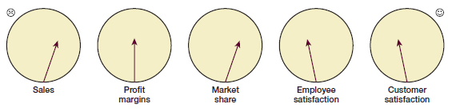
Marketing Metrics (slide 2 of 3)
Dashboard
32

Slide 33
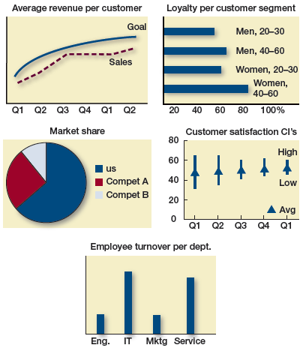
Marketing Metrics (slide 3 of 3)
33

Slide 34
Managerial Recap
Before making strategy changes, conduct a self-assessment
Consider what to change: target segments, product, price, place, or promotion
There are many ways to increase profitability, and some may fit corporate culture and strengths; there are goals beyond profitability
34

